Slide 1


IMDB DATABASE ANALYSIS- ADVANCED SQL PROJECT
BY
JOTHEESWARAN.S
01.04.2025
DA&DS
FEB’25
Notes:
To change the image on this slide, select the picture and delete it. Then click the Pictures icon in the placeholder to insert your own image.

Slide 2
DATASET OVERVIEW AND OBJECTIVES
The dataset provided is a simplified version of the IMDb database, structured to capture essential information about movies, their genres, actors, directors, ratings, and more.
AVAILABLE INFORMATION(SIX TABLES):
Movie: (7997 records)
Genre: (14662 records)
Director Mapping: (3867 records)
Role Mapping: (151615 records)
Names :(25735 records)
Ratings: (7997 records)

Slide 3
DATA DESCRIPTION
Movie: Contains basic information about each movie, including title, release year, duration, country, income, languages, and production companies. (7997 movies)
Genre: Describes the genres associated with each movie.(12 genres)
Director Mapping: Maps movies to their directors.
Role Mapping: Maps actors/actresses to movies and specifies the role category
Names: Stores information about people including their birthdates, heights, and known movies.
Ratings: Contains ratings information for movies, including the average rating, total votes, and median rating

Slide 4
KEY METRICS
Joins: Combine data from multiple tables.
Aggregation: Calculate summary statistics (e.g., averages, totals).
Filtering: Narrow down data to specific subsets.
Grouping: Categorize data into groups.
Ranking: Rank data based on specific criteria.
Sorting: Arrange data in ascending or descending order.
Sub-Query: Use a query within another query to retrieve specific data.

Slide 5
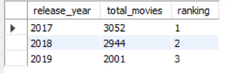
TRENDS OVER TIME
OVER A YEAR
2017: 3,052 movies released (peak)
2018: 2,944 movies released (3% decrease)
2019: 2,001 movies released (32% decrease from 2018, 34% decrease from 2017)
This downward trend suggests a significant reduction in movie production or release over the three-year period.

Slide 6
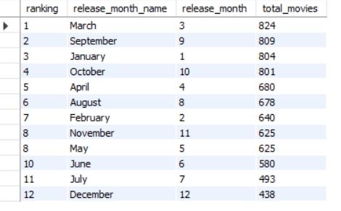
OVER A MONTH
The data shows that March sees the highest number of movie releases (824), followed closely by September (809) and January (804). Mid-year months like June and July have fewer releases, with December having the least at 438. This suggests that the first and last quarters are peak times for movie launches.

Slide 7
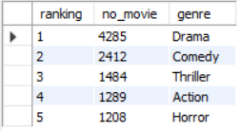
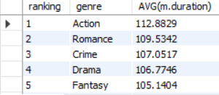
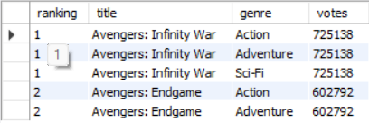
GENRE-BASED ANALYSIS
Drama tops the chart with 4285 movies, followed by Comedy (2412) and Thriller (1484). Action (1289) and Horror (1208) complete the list, showing strong but comparatively lower appeal.
Action movies have the highest average duration at (112.88) minutes, followed by Romance (109.53) and Crime (107.05). Drama and Fantasy are slightly shorter.
"Avengers: Infinity War" leads with 725,138 votes across Action, Adventure, and Sci-Fi genres, while "Avengers: Endgame" follows with 602,792 votes in Action and Adventure.

Slide 8
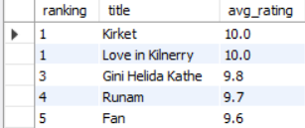
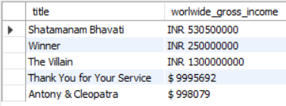
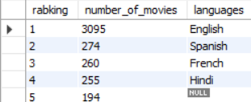
MOVIES BASED ANALYSIS
We can see that the movie Kirket has the highest average rating of 10. closely followed by Love in Kilnerry with an equally impressive rating of 10. Gini Helida kathe are trailed by with 9.8 and Runam with 9.7.
The dataset lists movies with worldwide gross income in INR and USD. Indian films have higher earnings, with "The Villain" leading at INR 1,300,000,000, while "Antony & Cleopatra" has the lowest at $998,079. This highlights revenue differences across film industries.
The dataset ranks languages by the number of movies, with English leading at 3,095 films. Spanish, French, and Hindi follow, while the fifth-ranked language is missing (NULL). The gap between English and other languages is significant.

Slide 10
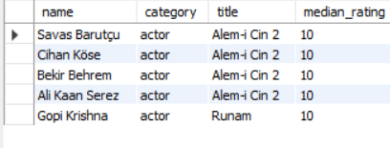
ACTOR BASED ANALYSIS
The dataset features top five actors, all with a perfect median rating of 10 for their respective movies. Four actors—Savas Barutçu, Cihan Köse, Bekir Behrem, and Ali Kaan Serez—are associated with Alemi Cin 2, while Gopi Krishna is linked to Runam.

Slide 11
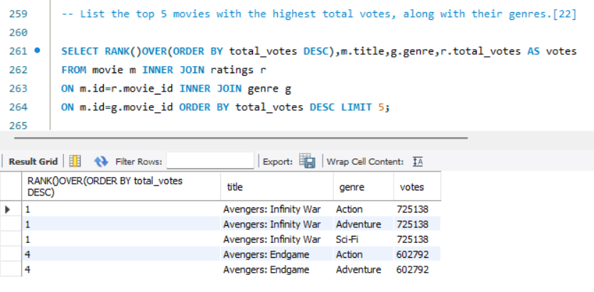
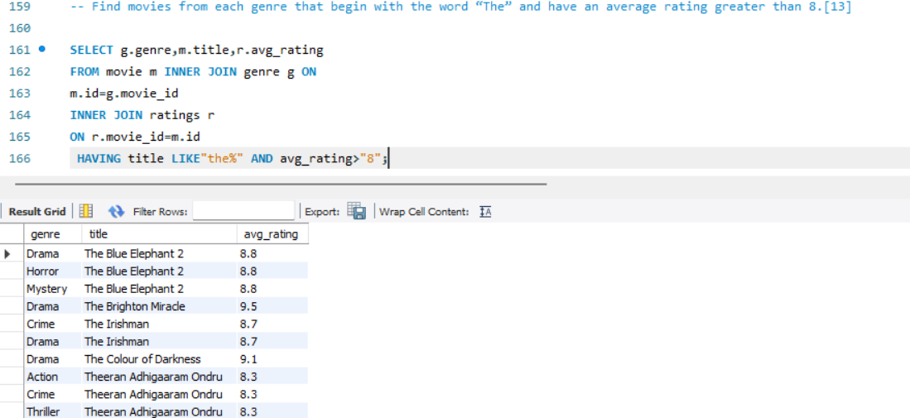
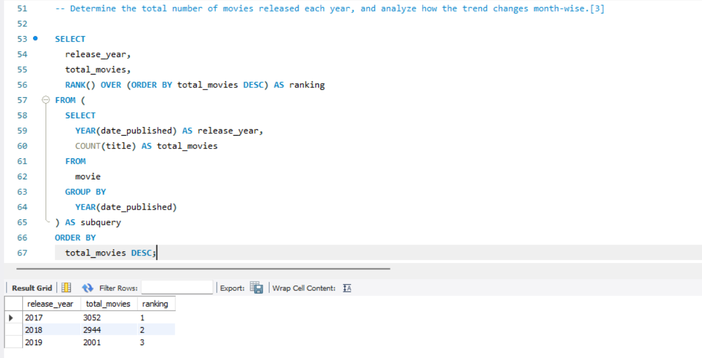
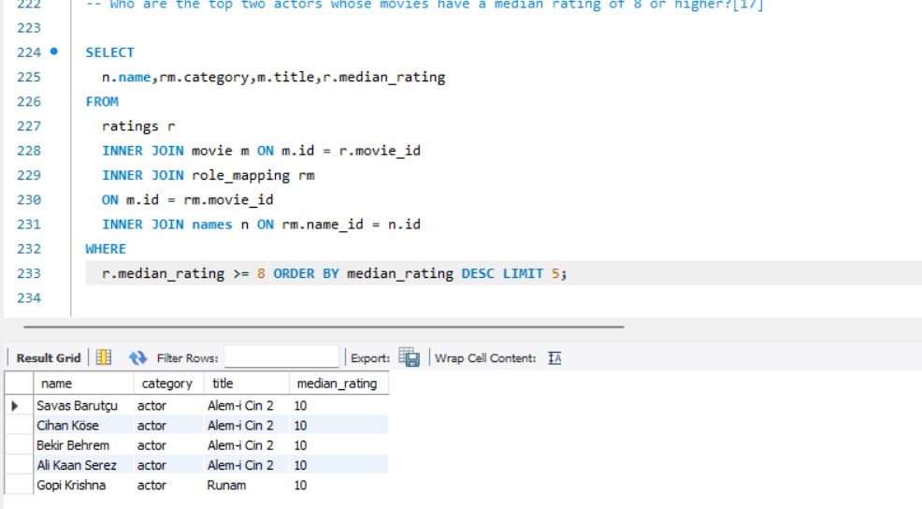
QUERIES AND OUTPUT

Slide 12
CONCLUSION
Movie releases peak in first and third quarters especially in March, September, and October.
2017 had the highest movie count, while 2019 had the least.
Drama is the most dominant genre, providing opportunities for directors.
Movie production is declining yearly.
English is the most common language that used across world,On other hand USA holds the record of highest movie released country.
More audience engagement is needed through ratings,votes and grouping all genres together in a single title.

Slide 13
THANK YOU!

